Slide 1
Introduction to ONC BOCES Purchasing
Updated August 2018

Slide 2
Agenda
Purchasing
Guidelines
Where to start
Requisition Entry
Helpful Reminders
PO Approval Process
P-Card

Slide 3
What guides our Purchasing process?
Board policy (can be found our website)
Policy #6700 Purchasing
Policy #6700-R Purchasing Regulation
Policy #6710 Purchasing Authority
Policy #6740 Purchasing Procedures
Policy #6740-R Purchasing Procedures Regulation
Policy #6830 Expense Reimbursement
Policy #8334 Use of District Credit Cards

Slide 4
Purchasing Directive from BOE
Policy #6700 Purchasing
“….to purchase competitively, without prejudice or favoritism, and to seek the maximum educational value for every dollar expended”
“Competitive bids or quotations shall be solicited in connection with purchases pursuant to law.”

Slide 5
How to accomplish Purchasing directive from BOE….
Policy #6700-R Purchasing Regulation
Establishes best value
Describes General Municipal Law for bidding purposes
Establishes quoting thresholds

Slide 6
How to accomplish Purchasing directives from BOE….
Policy # 6710 Purchasing Authority
Designates School Business Executive (Director of Management Services) as Purchasing Agent
PO is not a PO until approved by the Purchasing Agent
Policy #6740 Purchasing Procedures
Required to have procedures on how purchasing is to be done at our BOCES
Policy #6740-R Purchasing Procedures Regulation
A broad overview of procedures

Slide 7
So many policies… where do I start?

Slide 8
Purchasing
Where do I start?
Is item or service less than $20,000?
3rd Question
1st Question
2nd Question
Not required to buy from bid, but should always look to get best price or value!
Best
Price
or
Value
Is item or service $20,000 or more?
Is item or service “LIKE” other items or services purchased by other ONC Programs?
Follow quote guidelines:
Cost less than $500
Cost $500 to $2,500
Cost $2,501 to $5,000
Cost $5,001 to $19,999
Must be purchased on a bid
Does the BOCES purchase $20,000 or more of these like items or services?
No additional quote needed
2 verbal quotes (one using plus another)
2 written quotes
3 formal quotes
If Professional Services (architect, accountant, attorney) – need to do RFP
Bids:
DCMO bids, NYS contract, ONC BOCES bid, National Purchasing Cooperative bid
Examples: office supplies, welding supplies, technology, culinary (food)
Remember:
Threshold is not per vendor
Need vendor name, person who gave quote, date and price
Quotes on vendor letterhead or internet price sheet with price circled.
Quotes on vendor letterhead or internet price sheet with price circled.

Slide 9
Next steps after the 3 questions…..
Cathy Jacob
Purchasing Assistant
cjacob@oncboces.org
(607) 588-6291 ext. 2126
Make decision on need to bid or gather quotes.
If unsure… ask!! Or if you just want confirmation… ask!!
Need information on available bids, NYS Contract, National Purchasing Cooperatives or where to go to get quotes…. Ask!
Need back up for your decision.
Documentation to show we are following our purchasing policy.

Slide 10
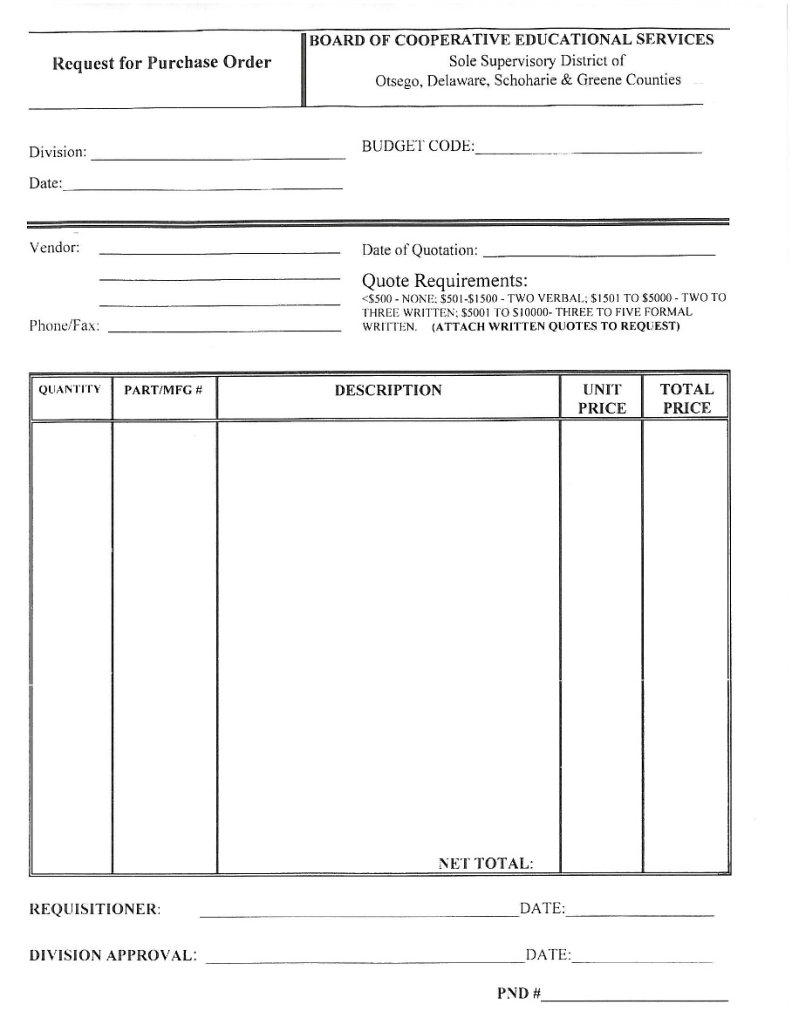
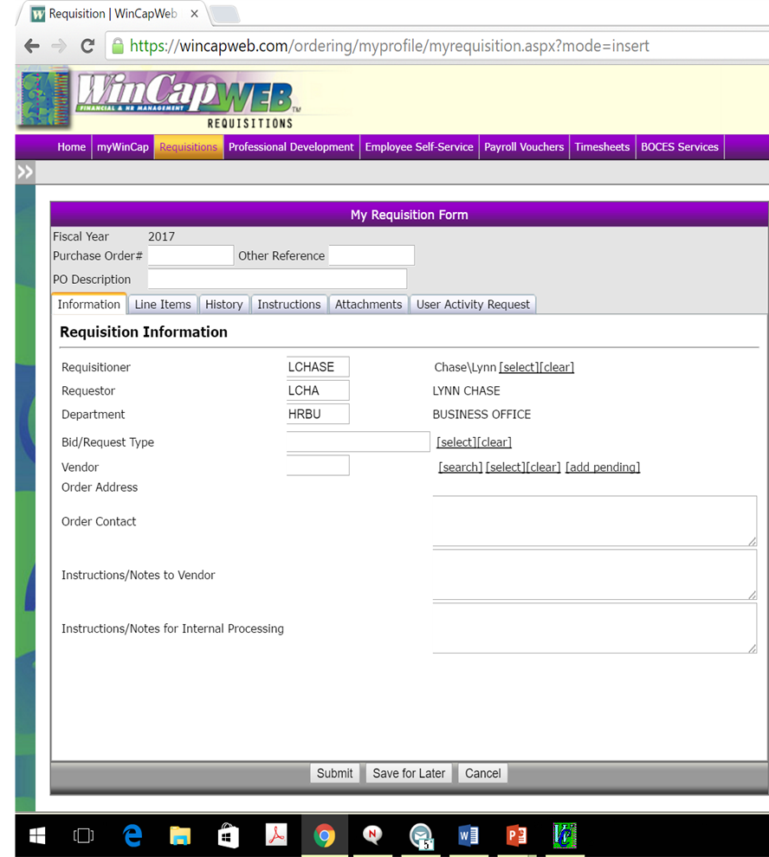
Time to enter a requisition…….

Slide 11
Requisition Entry
MyWinCap Web Requisition Instructions link:
http://www.oncboces.org/UserFiles/Servers/Server_524527/File/Migration/Business/Business%20Office%20Info%20&%20Forms/Web%20Req%20Instructions.pdf

Slide 12
PO Entry - Helpful Reminders
Each purchase order is a contract with vendor... it needs to be complete.
Need to know what is being purchased… not just item numbers. Please use complete descriptions.

Slide 13
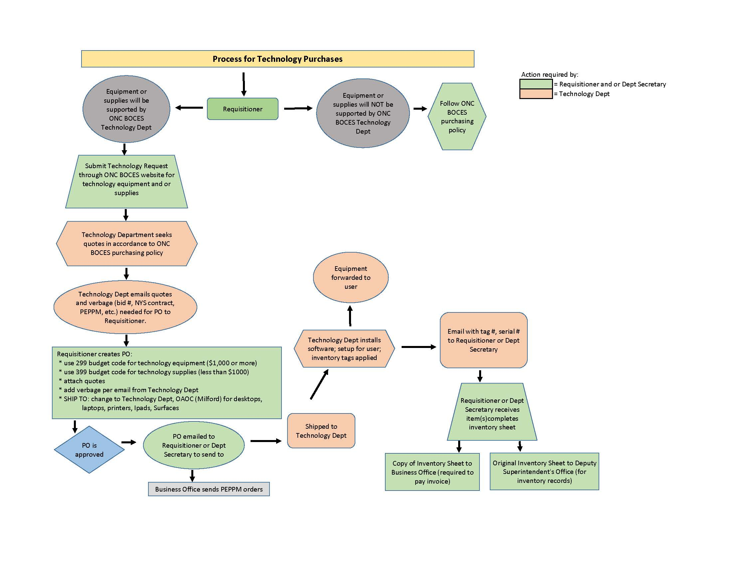
PO Entry - Helpful Reminders
Technology purchases are handled differently.
Here is a flowchart to assist with any technology purchases:
Contact Gen Ballard with any questions

Slide 14
PO Approval Process
There are eight levels in the PO approval process.
Why?
Purchasing Assistant reviews all requisitions to ensure compliance with our purchasing policies.
Principals/Program Leaders/Coordinators/Directors/Assistant Superintendent are responsible for their own programs and budgets. They need to be able to approve or disapprove each purchase.
Technology purchases need approval by our Network Administrator.
Deputy Superintendent oversees all programs and wants to know what is being purchased.
Purchasing Agent approval is required.

Slide 15
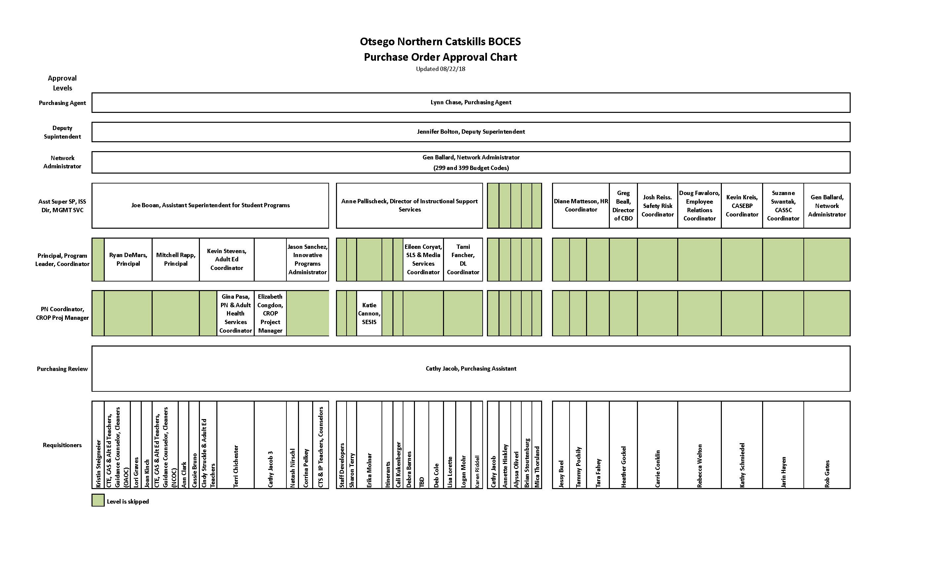

Slide 16
PO Approval Process
As a requisitioner, if you receive an email from WinCap about a requisition needing approval…..
This means your PND(requisition) has been referred back to you.
Check the history… the reason why it was referred back will be under the approver who referred it back with a reason.
Make the correction and submit again.

Slide 17
PO Approval Process
Once PO is approved, PO is sent to Program Secretary who disburses it to vendor.
Program Secretary tracks all purchase orders and receives them in when delivered.
Vendors should send all original invoices to the Business Office (mail or electronically to accountspayable@mail.oncboces.org)

Slide 18
P-Card
What is a p-card?
P = “Payment” (credit card)
Must have an approved PO in place before using p-card!
$0 credit limit until increased with approved PO amounts
Detailed receipts are required
You will be invoiced for purchases not in compliance with ONC BOCES purchasing policy
Optional
If interested, contact Cathy Jacob, Purchasing Assistant.

Slide 19
Questions?
Contact Information:
Lynn Chase lchase@oncboces.org
(607) 588-6291 ext. 2172
Cathy Jacob cjacob@oncboces.org
(607) 588-6291 ext. 2126

